Slide 1


Slide 2



Public services
A public service is a service provided by public authorities, public institutions

Slide 3
Types of public services
Railway station - железнодорожная станция
Bank – банк
Post office - почтовое отделение
Police station - полицейский участок
Library – библиотека
Town hall - городская ратуша
Petrol station - заправочная станция
Hospital – больница
Fire station - пожарная станция

Slide 4
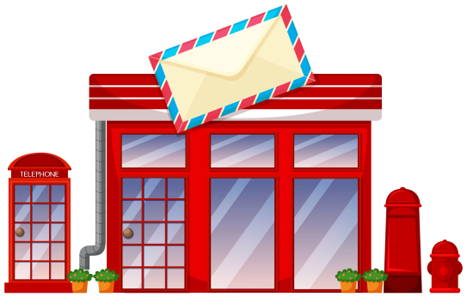

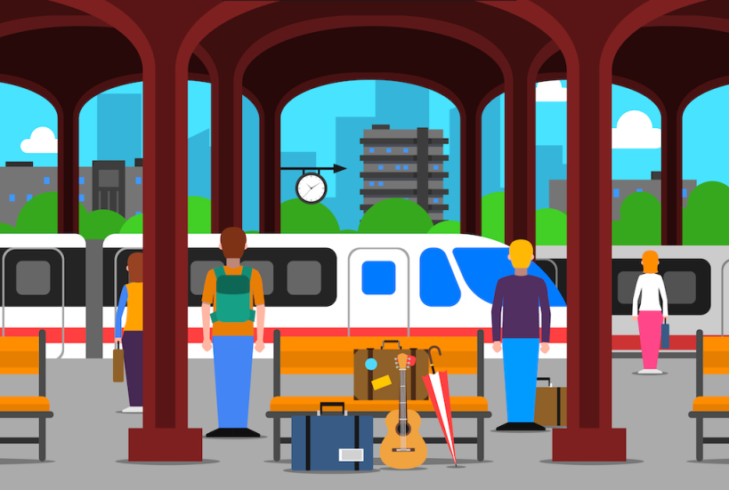

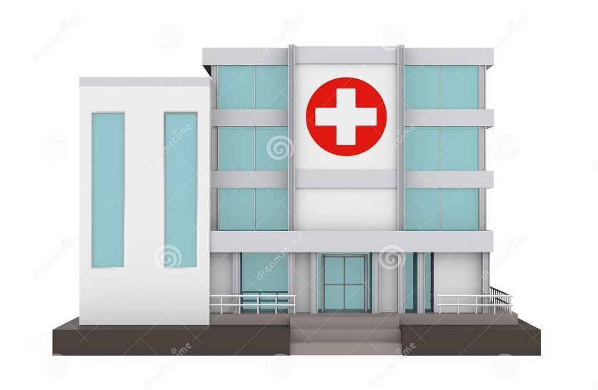
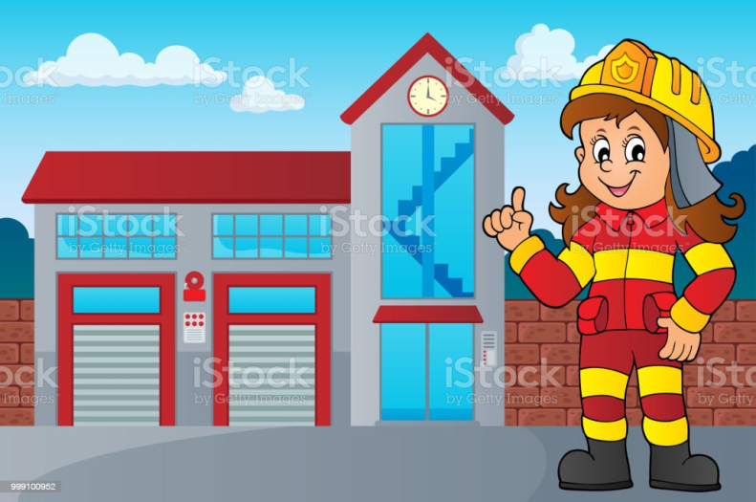
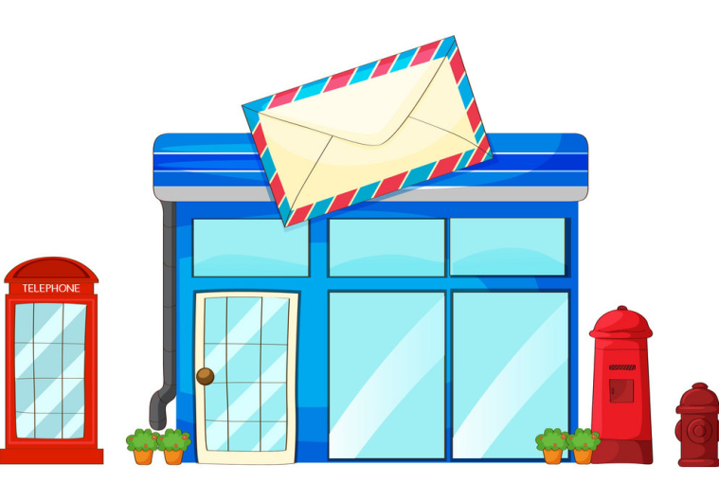
CONNECT THE WORDS WITH A SUITABLE PICTURE
Post office
Hospital
Railway station
Library
Fire station

Slide 5
Translate
Nurse
Attendant
Surgeon
Doctor
Librarian
Mayor
Secretary
Police officer
Forensic scientist
Detective
Cashier
Postal worker
Fire officer
Postman
Медсестра
Служитель
Хирург
Доктор
Библиотекарь
Мэр
Секретарь
Полицейский
Криминалист
Детектив
Кассир
Почтальон
Пожарный
Почтальон

Slide 6
Match the sentences to make exchanges
Two stamps, please
Two second-class tickets to Manchester, please
I’d like to send this parcel to France, please
I’m just returning these books
I’d like to withdraw some money from my account, please
I’d like to open an account, please
Which platform does the 8:30 from London arrive at?
Excuse me, have you got «Harry Potter and Philosopher’s Stone?»
Single or return?
Platform twelve
Certainly. How much?
I’m afraid it’s out right now. Would you like to reserve it
First or second-class?
OK. Could you fill in this form?
They’re a week overdue. That’s one pound, please
Can you put it on the scales?

Slide 7

Appendix 3
Idioms
By myself - сам
Make herself heard - услышать
Make herself clear - объясниться
Help yourself - угощайся
Did it herself – сделать самому
Enjoy yourself - наслаждаться
Behave herself – вести себя
A:Mmm. Can I have one these cakes?
B:Help yourself!
A:Did your friends help you paint your room?
B:No, I did it myself
A:Don’t ever do that again! Do I make myself clear?
B:Yes. I’m sorry
A:Rob had a lot to say at the meeting didn’t he?
B:Yes, he certainly likes to make himself heard!

Slide 8
Thank you for your attention!

